Slide 1
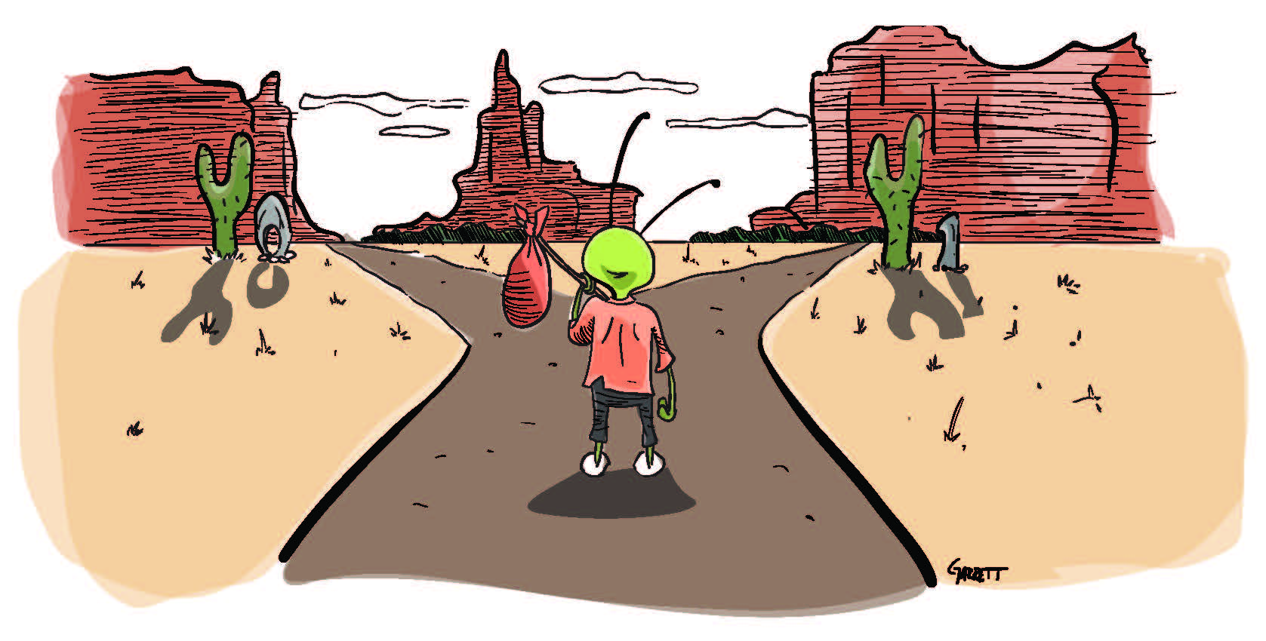
RANDOMIZED TRIALS I
José Manuel Arencibia Alemán & Isa Steinmann
Session 3
Source: Joshua Angrist

Slide 2

Last session’s take-away messages
(Quasi-)experiments have the potential to answer causal research questions, but not others.
Selection bias, feasibility and implementation, and generalization are the most central issues in (quasi-)experiments

Slide 3
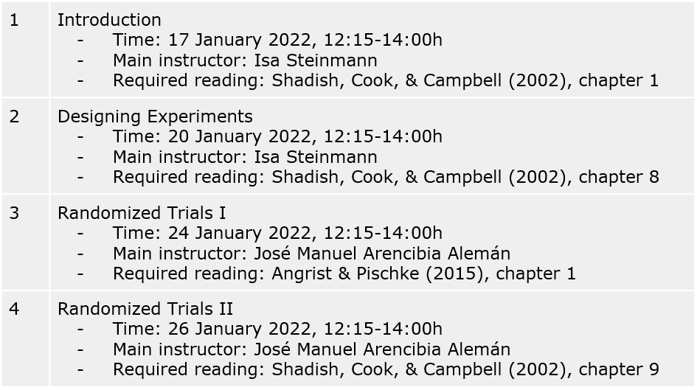

Slide 4

Roadmap
Potential Outcomes Effects
The Road Not Taken
Counterfactual
Differences in Groups
Fruitless comparisons
Randomized Control Trials
Fruitful comparisons
Ceteris Paribus
Interpretation of results
Photo by Taneli Lahtinen on Unsplash
Notes:
Invite them to take basic notes (they will get the slides later), because they are going to make a simple exercise later in pairs, and those notes may come Handy.
To the stdents: “Focus on formal expressions and attach meaning to them”

Slide 5
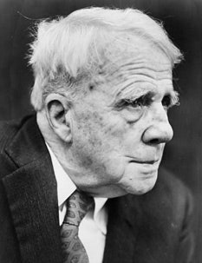
Potential Outcomes
The Road Not Taken
“Two roads diverged in a yellow wood, And sorry I could not travel both And be one traveler, long I stood And looked down one as far as I could To where it bent in the undergrowth; […] I shall be telling this with a sigh Somewhere ages and ages hence: Two roads diverged in a wood, and I— I took the one less traveled by, And that has made all the difference.”
Rober Frost
Source: The New Yorker

Slide 6



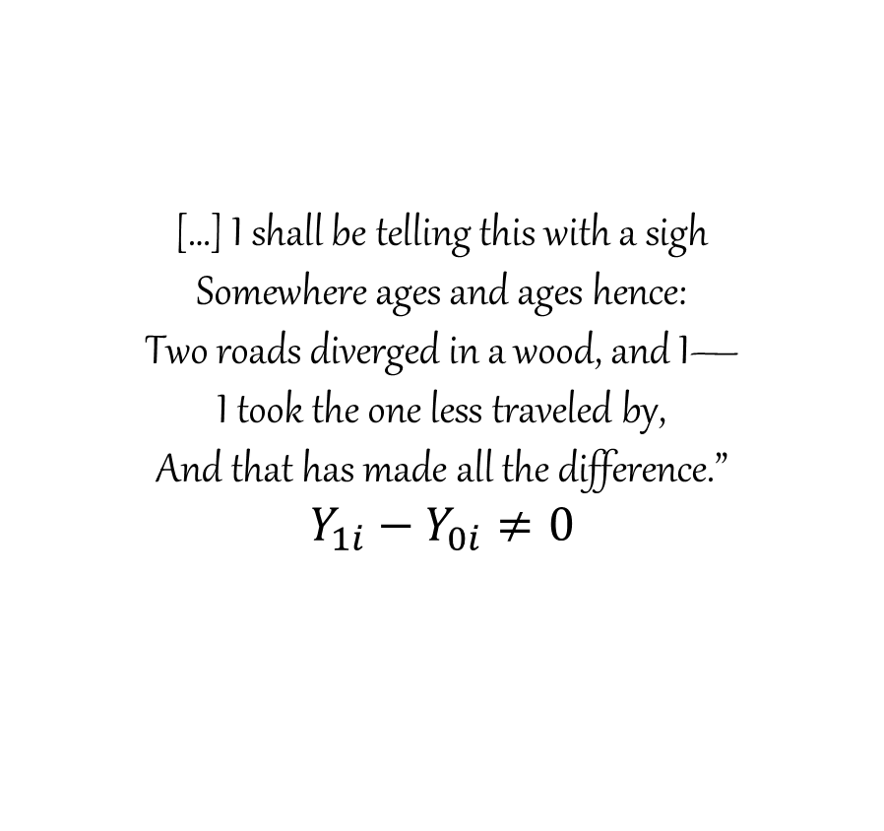
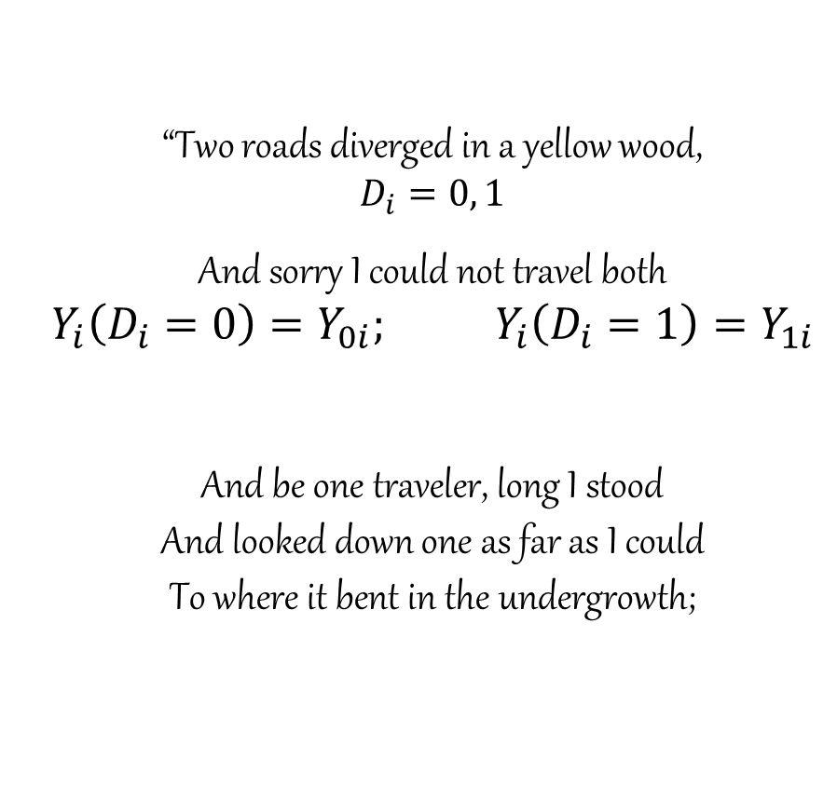
Potential Outcomes
“Two roads diverged in a yellow wood,
$$D_{i}=0, 1$$
And sorry I could not travel both
$$Y_{i}\left(D_{i}=0\right)=Y_{0i}; Y_{i}\left(D_{i}=1\right)=Y_{1i}$$
And be one traveler, long I stood And looked down one as far as I could To where it bent in the undergrowth;
[…] I shall be telling this with a sigh Somewhere ages and ages hence: Two roads diverged in a wood, and I— I took the one less traveled by, And that has made all the difference.”
$$Y_{1i}−Y_{0i}≠0$$

Slide 7
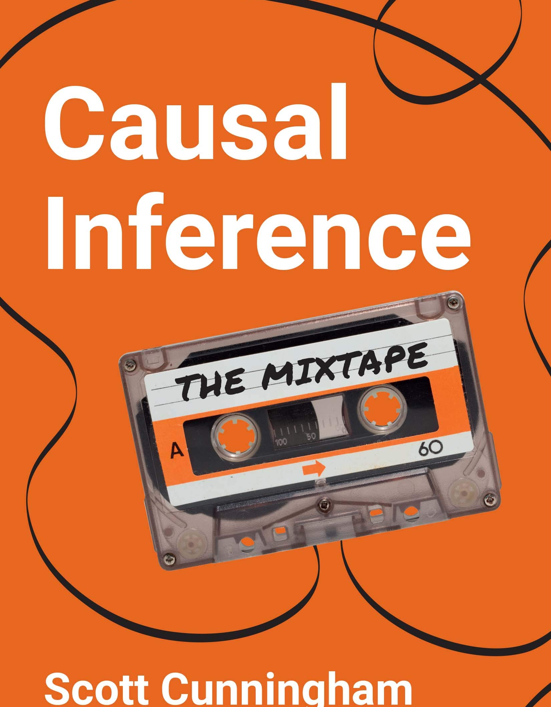
Potential Outcomes
Counterfactual
Counterfactuals are alternative states of the world:
“What if Bruce Wayne’s parents had never been murdered? […] What if in The Matrix Neo had taken the blue pill? […] We need Doctor Strange to give us the Time Stone to answer questions like these.” (Cunningham, 2021)
We don’t know what would have happened had one event changed because we are missing data on the counterfactual outcome
Cunningham, S. (2021). Causal inference : the mixtape. New Haven, Connecticut, Yale University Press https://mixtape.scunning.com/potential-outcomes.html .

Slide 8


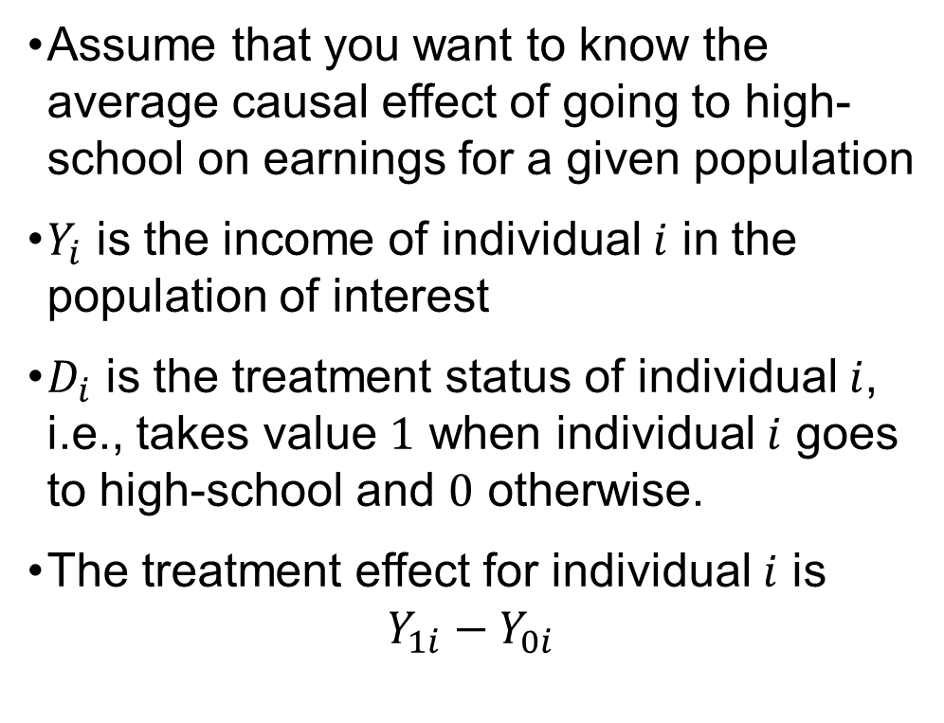
Differences in Groups
Fruitless comparisons
Assume that you want to know the average causal effect of going to high-school on earnings for a given population
$Y_{i}$ is the income of individual $i$ in the population of interest
$D_{i}$ is the treatment status of individual $i$, i.e., takes value $1$ when individual $i$ goes to high-school and $0$ otherwise.
The treatment effect for individual $i$ is
$$Y_{1i}−Y_{0i}$$
Photo by Yasir Slash on Unsplash

Slide 9
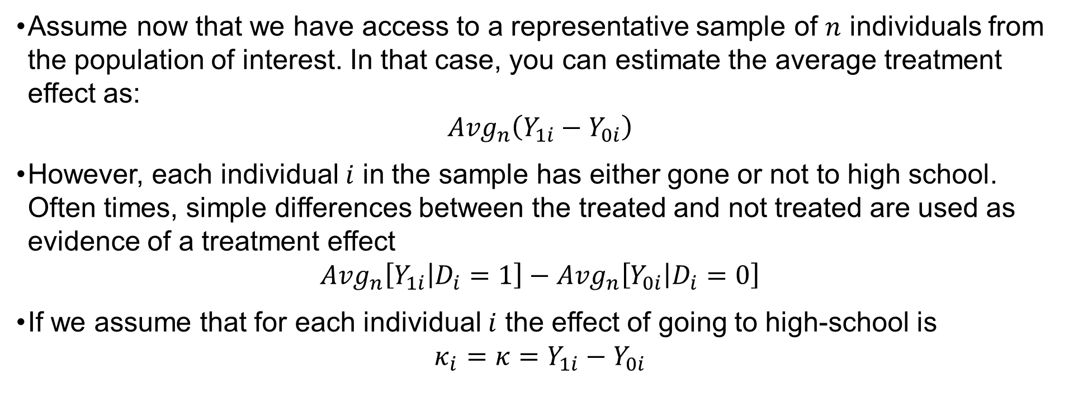
Differences in Groups
Fruitless comparisons
Assume now that we have access to a representative sample of $n$ individuals from the population of interest. In that case, you can estimate the average treatment effect as:
$${Avg}_{n}\left(Y_{1i}−Y_{0i}\right)$$
However, each individual $i$ in the sample has either gone or not to high school. Often times, simple differences between the treated and not treated are used as evidence of a treatment effect
$${Avg}_{n}\left[Y_{1i} | D_{i}=1\right]−{Avg}_{n}\left[Y_{0i} | D_{i}=0\right]$$
If we assume that for each individual $i$ the effect of going to high-school is
$$κ_{i}=κ=Y_{1i}−Y_{0i}$$

Slide 10
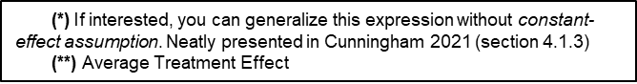
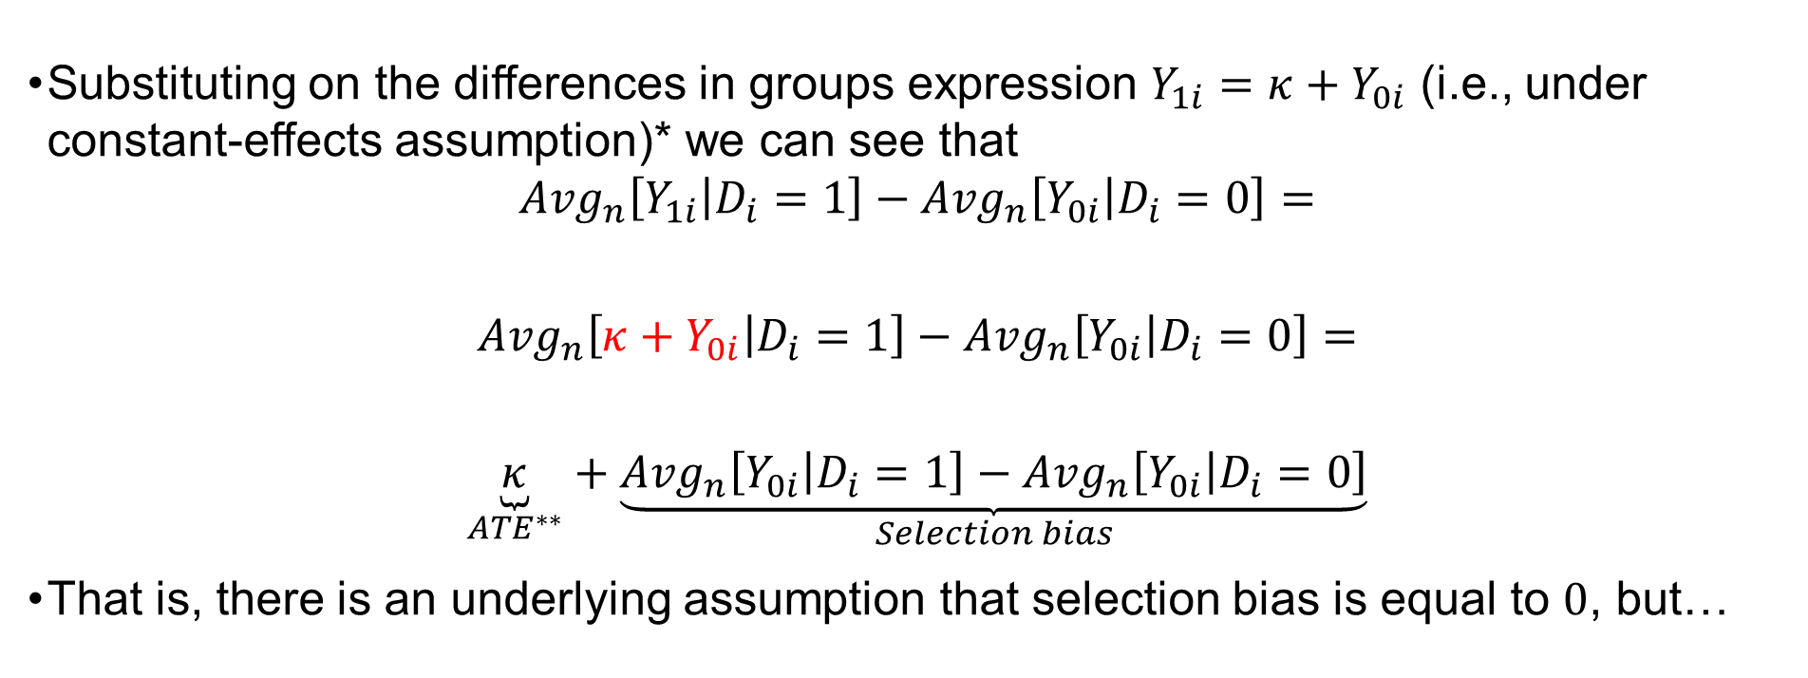
Differences in Groups
Fruitless comparisons
Substituting on the differences in groups expression $Y_{1i}=κ+Y_{0i}$ (i.e., under constant-effects assumption)* we can see that
$${Avg}_{n}\left[Y_{1i} | D_{i}=1\right]−{Avg}_{n}\left[Y_{0i} | D_{i}=0\right]=$$
$${Avg}_{n}\left[κ+Y_{0i} | D_{i}=1\right]−{Avg}_{n}\left[Y_{0i} | D_{i}=0\right]=$$
$$\underset{{ATE}^{∗∗}}{\underbrace{κ}}+\underset{Selection bias}{\underbrace{{Avg}_{n}\left[Y_{0i} | D_{i}=1\right]−{Avg}_{n}\left[Y_{0i} | D_{i}=0\right]}}$$
That is, there is an underlying assumption that selection bias is equal to $0$, but…
(*) If interested, you can generalize this expression without constant-effect assumption. Neatly presented in Cunningham 2021 (section 4.1.3)
(**) Average Treatment Effect

Slide 11
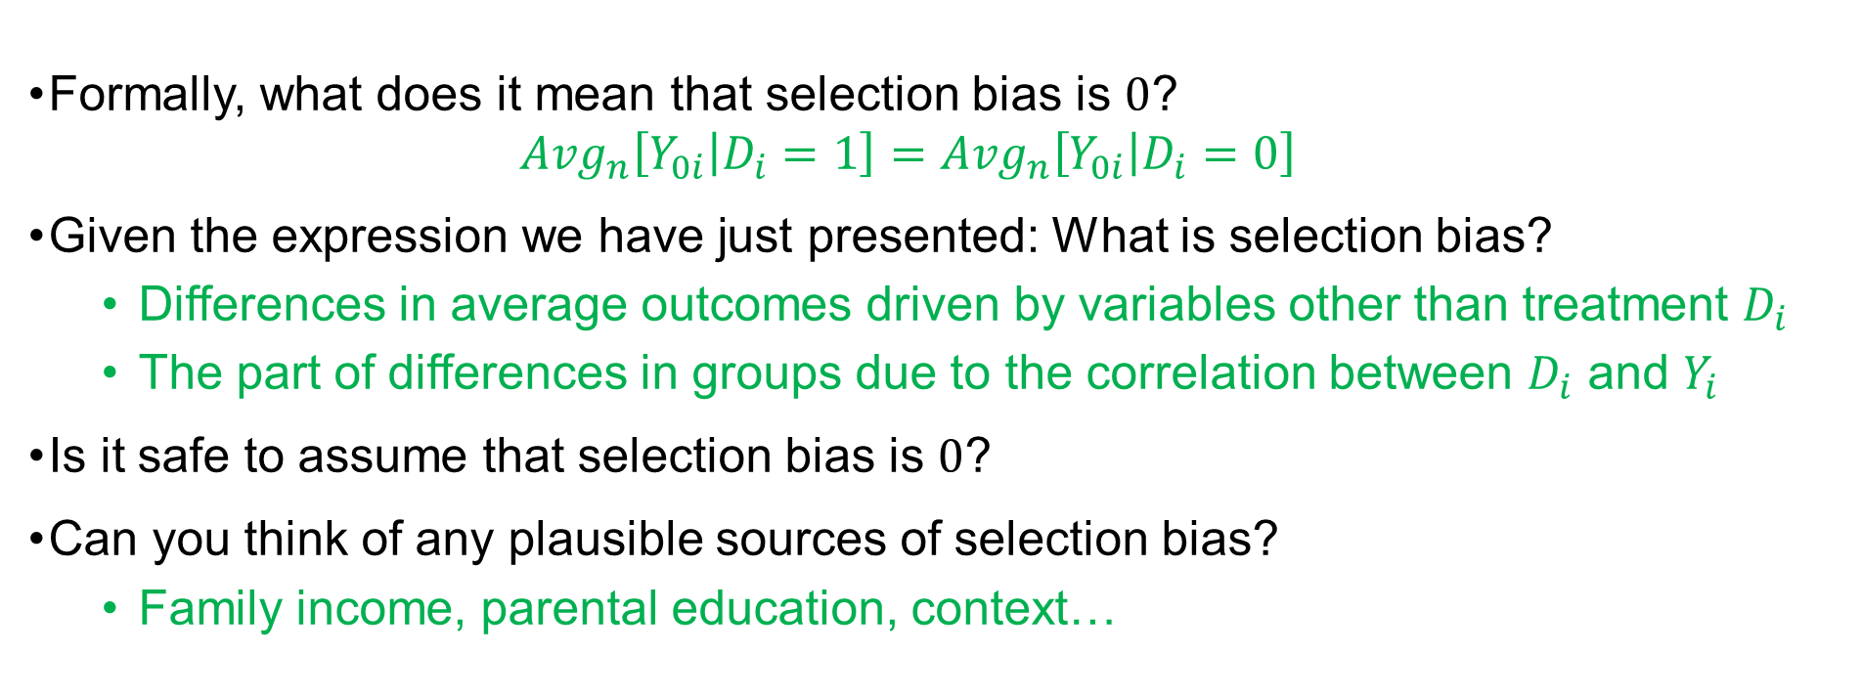
Differences in Groups
Ceteris Paribus?
Formally, what does it mean that selection bias is $0$?
$${Avg}_{n}\left[Y_{0i} | D_{i}=1\right]={Avg}_{n}\left[Y_{0i} | D_{i}=0\right]$$
Given the expression we have just presented: What is selection bias?
Differences in average outcomes driven by variables other than treatment $D_{i}$
The part of differences in groups due to the correlation between $D_{i}$ and $Y_{i}$
Is it safe to assume that selection bias is $0$?
Can you think of any plausible sources of selection bias?
Family income, parental education, context…
Notes:
Exercise: In pairs (maybe 5-7 min)

Slide 12
“The principal challenge facing masters of metrics is elimination of the selection bias that arises from such unobserved differences.” (Angrist and Pischke 2015, p. 11).
Why?
Notes:
Why:
Selection bias
Unobservable variables
If observable variables -> Control variables – refer to next lecture on regression analysis (?)

Slide 13

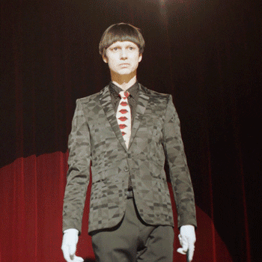
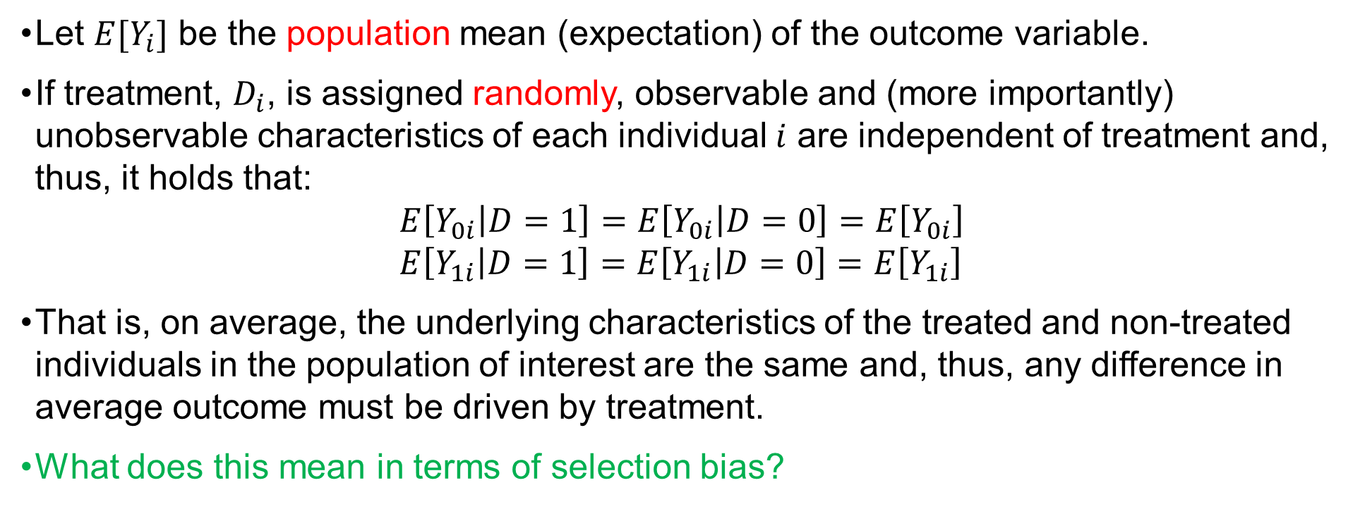
Randomized Control Trials
Fruitful comparisons
Let $E[Y_{i}]$ be the population mean (expectation) of the outcome variable.
If treatment, $D_{i}$, is assigned randomly, observable and (more importantly) unobservable characteristics of each individual $i$ are independent of treatment and, thus, it holds that:
$$E\left[Y_{0i} | D=1\right]=E\left[Y_{0i} | D=0\right]=E\left[Y_{0i}\right] \\ E\left[Y_{1i} | D=1\right]=E\left[Y_{1i} | D=0\right]=E\left[Y_{1i}\right]$$
That is, on average, the underlying characteristics of the treated and non-treated individuals in the population of interest are the same and, thus, any difference in average outcome must be driven by treatment.
What does this mean in terms of selection bias?

Slide 14
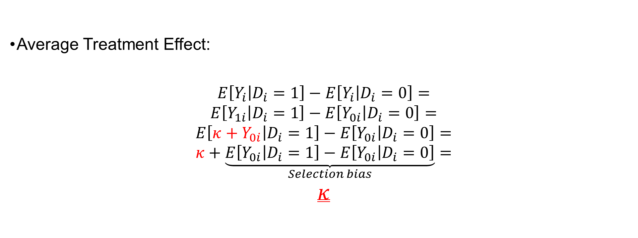
Randomized Control Trials
Fruitful comparisons
Average Treatment Effect:
$$E\left[Y_{i} | D_{i}=1\right]−E\left[Y_{i} | D_{i}=0\right]=$$
$$E\left[Y_{1i} | D_{i}=1\right]−E\left[Y_{0i} | D_{i}=0\right]=$$
$$E\left[κ+Y_{0i} | D_{i}=1\right]−E\left[Y_{0i} | D_{i}=0\right]=$$
$$κ+\underset{Selection bias}{\underbrace{E\left[Y_{0i} | D_{i}=1\right]−E\left[Y_{0i} | D_{i}=0\right]}}=$$
$$κ$$

Slide 15
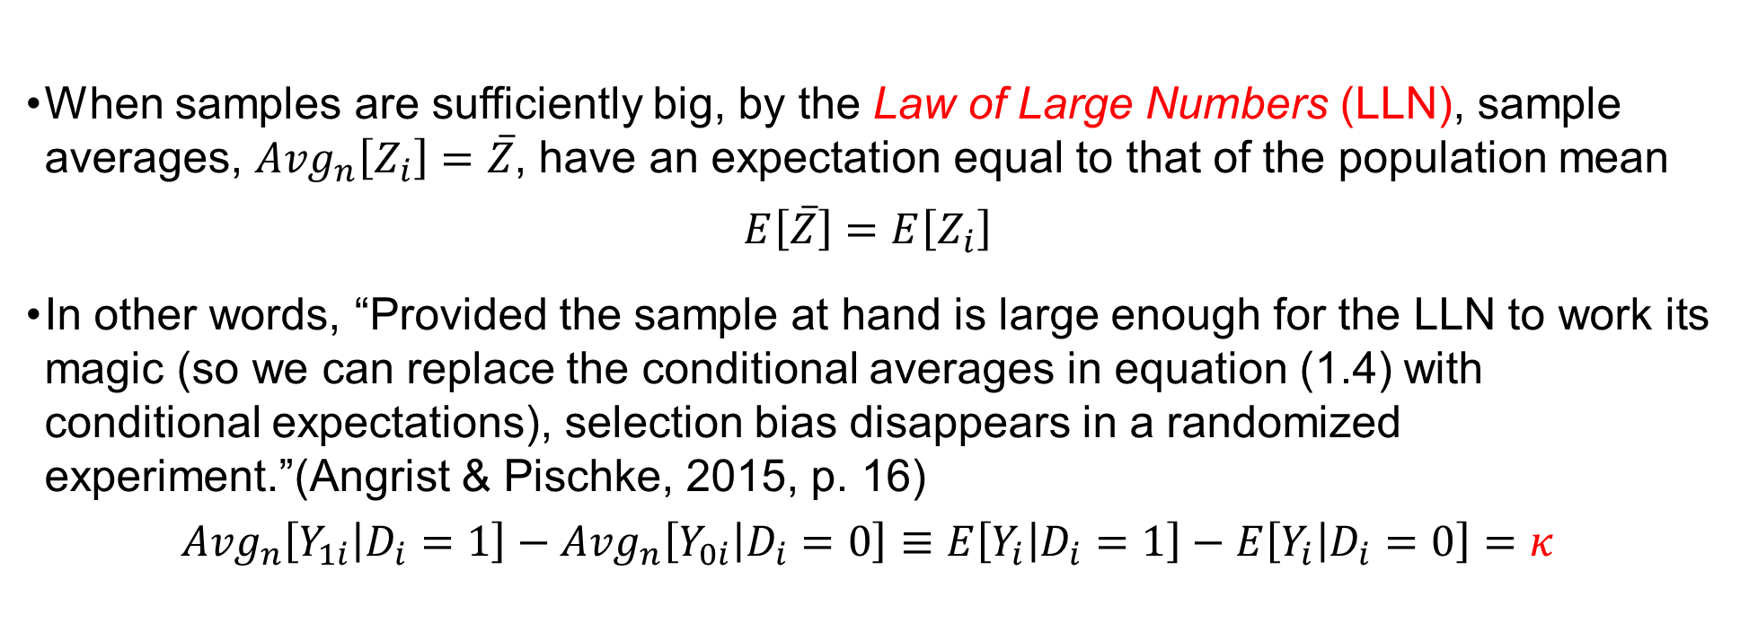
Randomized Control Trials
Fruitful comparisons
When samples are sufficiently big, by the Law of Large Numbers (LLN), sample averages, ${Avg}_{n}\left[Z_{i}\right]=\overline{Z}$, have an expectation equal to that of the population mean
$$E\left[\overline{Z}\right]=E\left[Z_{i}\right]$$
In other words, “Provided the sample at hand is large enough for the LLN to work its magic (so we can replace the conditional averages in equation (1.4) with conditional expectations), selection bias disappears in a randomized experiment.”(Angrist & Pischke, 2015, p. 16)
$${Avg}_{n}\left[Y_{1i} | D_{i}=1\right]−{Avg}_{n}\left[Y_{0i} | D_{i}=0\right]≡E\left[Y_{i} | D_{i}=1\right]−E\left[Y_{i} | D_{i}=0\right]=κ$$
Notes:
The LLN implies that when the sample is sufficiently large, the properties (distribution) of the sample closely resemble those of the population. This, in combination with random assignment to treatment, allow us to isolate the effect of treatment.

Slide 16

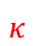
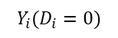
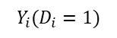
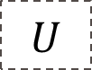
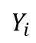
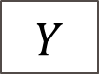
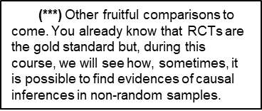
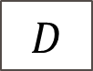
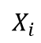
Randomized Control Trials
Fruitful comparisons
Ceteris Paribus
An ideal*** fruitful comparison requires:
A large (and representative) sample (large enough for the LLN “to make its magic”)
Random assignment to treatment
“Random assignment works not by eliminating individual differences but rather by ensuring that the mix of individuals being compared is the same. Think of this as comparing barrels that that include equal proportions of apples and oranges” (Angrist & Pischke, 2015, p.16)
$$Y_{i}$$
$$Y_{i}(D_{i}=1)$$
$$κ$$
$$Y_{i}(D_{i}=0)$$
$$U$$
(***) Other fruitful comparisons to come. You already know that RCTs are the gold standard but, during this course, we will see how, sometimes, it is possible to find evidences of causal inferences in non-random samples.
Source: The Data School
$$X_{i}$$
$$D$$
$$Y$$
Notes:
The LLN implies that when the sample is sufficiently large, the properties (distribution) of the sample closely resemble those of the population. This, in combination with random assignment to treatment, allow us to isolate the effect of treatment.

Slide 17
First step is to ensure that random assignment (and the LLN) has made treatment and control groups similar: checking for balance
Characteristics of the groups (basic control group design)
Pre-treatment outcomes (pretest-posttest control group design)
Notes:
Why:
Selection bias
Unobservable variables
If observable variables -> Control variables – refer to next lecture on regression analysis (?)
Examples from Isas experimental design slides

Slide 18
Randomized Control Trials
Table 1.1 (Non-Random assignment) Husbands’ Characteristics (Angrist & Pischke, 2015, p.5)
Table 1.3 (“Random” assignment) Selected Char. & pre-treatment outcomes (Angrist & Pischke, 2015, p.20)
Characteristics | Some HI | NO HI | Difference
Nonwhite | .16 | .17 | -.01
 |  |  | (.01)
Age | 43.98 | 41.26 | 2.71
 |  |  | (.29)
Education | 14.31 | 11.56 | 2.74
 |  |  | (.10)
Family size | 3.50 | 3.98 | -.47
 |  |  | (.05)
Employed | .92 | .85 | .07
 |  |  | (.01)
Family Income | 106,467 | 45,656 | 60,810
 |  |  | (1,355)
Characteristics | Catastrophic(1) | Deductible-(1) | Coinsurance-(1)
Female | .560 | -.023 | -.025
 |  | (.016) | (.015)
Nonwhite | .172 | -.019 | -.027
 |  | (.027) | (.025)
Pre-treatment | Catastrophic(1) | Deductible-(1) | Coinsurance-(1)
Health Index | 70.9 | -1.44 | .21
 |  | (.95) | (.92)
Cholesterol | 207 | -1.42 | -1.93
 |  | (2.99) | (2.76)

Slide 19
Randomized Control Trials
Table 1.4 Selected health outcomes in the RAND HIE (Angrist & Pischke, 2015, p. 23)
Outcome variables | Catastrophic (1) | Deductible – (1) | Coinsur. – (1) | Free – (1) | Any insur. – (1)
Face-to-face visits | 2.78 | .19 | .48 | 1.66 | .90
 | [5.50] | (.25) | (.24) | (.25) | (.20)
Total expenses | 636 | 114 | 152 | 285 | 198
 | [2,535] | (79) | (85) | (72) | (63)
General health index | 68.5 | -.87 | .61 | -.78 | -.36
 | [15.9] | (.96) | (.90) | (.87) | (.77)
Cholesterol (mg/dl) | 203 | .69 | -2.31 | -1.83 | -1.32
 | [42] | (2.57) | (2.47) | (2.39) | (2.08)
Systol. blood pressure | 122 | 1.17 | -1.39 | -,52 | -.36
 | [19] | (1.06) | (.99) | (.93) | (.85)
Mental health index | 75.5 | .45 | 1.07 | .43 | .64
 | [14.8] | (.91) | (.87) | (.83) | (.75)

Slide 20
Randomized Control Trials
Interpretation of results
We have checked for balance, and we have found significant and insignificant average differences in the outcome variables of control and treated groups.
How do we interpret these results?
“These HIE findings convinced many economists that generous health insurance can have unintended and undesirable consequences, increasing health-care usage and costs without generating a dividend in the form of better health.” (Angrist & Pischke, 2015, p. 24)
But… do you remember limitations of the study affecting the conclusions (interpretations) of those economists?

Slide 21
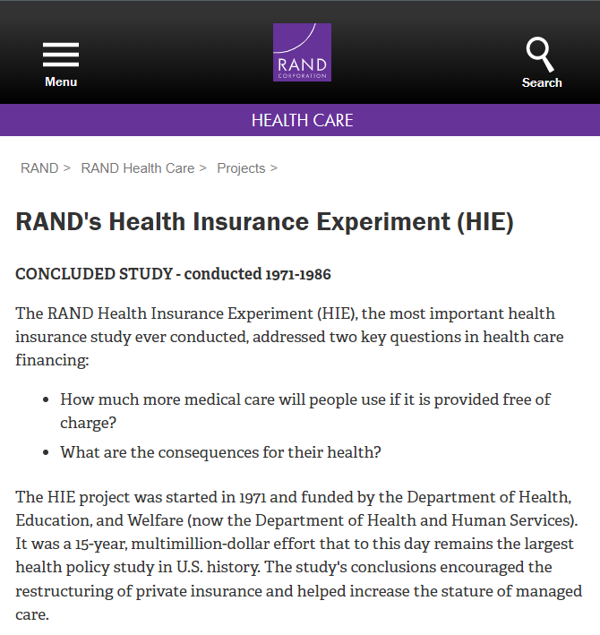
Randomized Control Trials
Interpretation of Results
Limitations of HIE RAND:
Limited treatments
Limited representability of the sample of uninsuranced population
Grouping ad-hoc due to the small size of the different treatments
Other threats in RCT:
Attrition
Missing data
Source: rand.org

Slide 22


Summing up

Slide 23
Take away messages
Group comparisons are, in general, “fruitless comparisons” due to selection bias
Randomized Control Trials allow us to get rid of selection bias and, thus, “fruitful caparisons”
Effective randomization requires the samples to be representative and large enough
We can evaluate whether the randomization process is successful by checking for balance in the characteristics and pre-treatment outcomes of the control and treatment samples
Inferring causal effects is a delicate process. Even after “successful” RCT, we have to be aware of possible threats to validity
Representability (external validity - generalizability)
Attrition and missing data

Slide 24
Take away messages
Group comparisons are, in general, “fruitless comparisons” due to selection bias.
Randomized Control Trials allow us to get rid of selection bias but require samples to be representative and large enough.
Even after a “successful” RCT, we have to be aware of possible threats to validity.

Slide 25
References
Angrist, J. D., & Pischke, J.-S. (2015). Mastering 'metrics : the path from cause to effect. Princeton University Press.
Cunningham, S. (2021). Causal inference : the mixtape. Yale University Press.

